Slide 1
Videolink Teacher Training
Lesson 5: PART 1
Please press F5 to start the presentation
请按住F5全屏播放

Slide 2
Lesson 5
Steps
self-study
自学
1. Learn
2. Review
3. Discuss
4. Teach

Slide 3


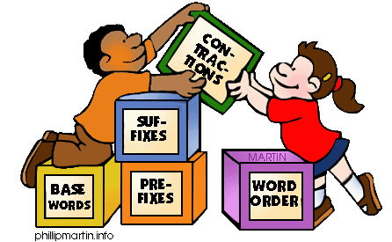

Grammar skills

Slide 4
The importance of GRAMMAR
语法的重要性
Why should I learn grammar? I am a teacher already…
我已经是老师了，为什么还要学语法？
  So I don't get embarrassed in the classroom
  避免在课堂上出丑
  Because it's an important part of learning English
  因为语法是英语很重要的一部分分
  So I can explain it if my students ask about it
  如果学生问起，我可以应付自如
  To help increase my confidence level in the classroom
  提升老师在课堂教课的自信

Slide 5
The importance of GRAMMAR
语法也重要
Why should students learn grammar?
学生为什么要学语法？
  Because it’s in their test
  应付考试语法环节
  Because speaking accurately and speaking fluently are just as important
  准确的英语和流利的英语一样重要
  Grammar is meaning: if it’s wrong, people might not understand
  语法可能影响你想要表达的信息
  Knowing the grammar, students can make their own new sentenc
  学生可以结合语法和词汇自由造句

Slide 6
Types of grammar teaching
语法教学的方式
1. Deductive
（演绎法）
SPECIFIC
GENERAL
2. Inductive
（归纳法）
GENERAL
SPECIFIC

Slide 7
What do they mean?
Deductive grammar teaching 演绎语法教学法
We give students a general rule, then we apply it to specific examples.
我们先给学生提供语法规则，再将它们应用在一些指定的场景
Inductive grammar teaching 归纳语法教学法
Students look at small specific language patterns, then figure out the general 'rule' by themselves.
学生先自己看应用场景，再找出指定的语法规则
Which one do you use most often? 你更喜欢使用哪一种？

Slide 8
Faster learning
学得更快
Easy to teach any grammar
更容易教语法
More time to teach the language
留出更多时间教语言
Deductive 演绎
Students remember more
学生记住更多
Students interact and participate
学生们可以相互沟通讨论
Deeper understanding of the language
对英语有更深入的了解
Develops critical thinking
培养批判性思维
Inductive 归纳

Slide 9


Deductive Teaching
演绎语法教学
Look at these verbs (动词). When we use 'he', 'she' or 'it', we add S.
I run fast.
He runs fast.
I eat.
She eats.
My cat (it) eats.
He
She
It
S
Now let's practice. Change the verbs from the book from 'You' to 'He'.

Slide 10
Inductive Teaching
归纳语法教学
Look at 'run'. Which one is different?
RUN
I run fast.
You run fast.
He runs fast.
They run fast.
We run fast.
He
She
It
S
So what's the rule for these 3?
(学生想想后告诉老师)
Good! 'He' is different. 'She' and 'it' too.
runs!

Slide 11

Now go back to the website to answer some questions!
回网站回答问题

