Slide 1
Videolink Teacher Training
Lesson 6: PART 3
Please press F5 to start the presentation
请按住F5全屏播放

Slide 2
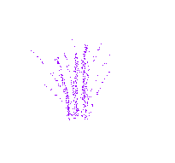
Great job!
Congratulations!
Online learning session 4 is finished!

Slide 3
Think!
What type of games do your students enjoy?
你的学生最喜欢哪种类型的游戏？
What type of games do you usually play with them?
你通常在课堂上进行哪种游戏？
How often do you play games? Why?
你多久在课上进行一次游戏活动？为什么？
Get ready to talk about it in the live class!
好好准备，下次跟老师在线上课的时候咱们一起讨论！

Slide 4

Lesson 4
Steps
1. Learn
2. Review
3. Discuss
4. Teach
Next time, live video class!
下次跟老师在线上课！
See you!
再见！

